Slide 1
Data and Annotation

Slide 2

Annotated Data
Tokens
English | Wikipedia The English Web Treebank (online reviews) 20 Thousand Leagues under the Sea The Little Prince Wall Street Journal (financial news) | 159,000 56,000 13,000 100 sentences 100 sentences
German | 20 Thousand Leagues under the Sea The Little Prince | 145,000 19,000
French | 20 Thousand Leagues under the Sea | 13,000
Hebrew | The Little Prince Wikipedia | 22,000 annotation underway
Russian | The Little Prince | annotation underway

Slide 3
The Annotation Process
Training
~ 30-50 hours
first stage: self-learning
second stage: feedback and agreement tests
Annotation process
2 annotators per passage: annotator and reviewer
corrections by the project manager (only clear-cut errors are corrected at this stage)
currently exploring: parsing+ manual corrections

Slide 4
The Annotation Process
Current workforce: 2 annotators
Means of communication with annotators:
comments in the task itself
meetings

Slide 5
UCCA-App
Open source, flexible web application
UCCA annotation is done on the UCCA-App
Supports syntactic and semantic phrase-based annotation in general
Simple and intuitive UI, supports annotation by non-experts

Slide 6
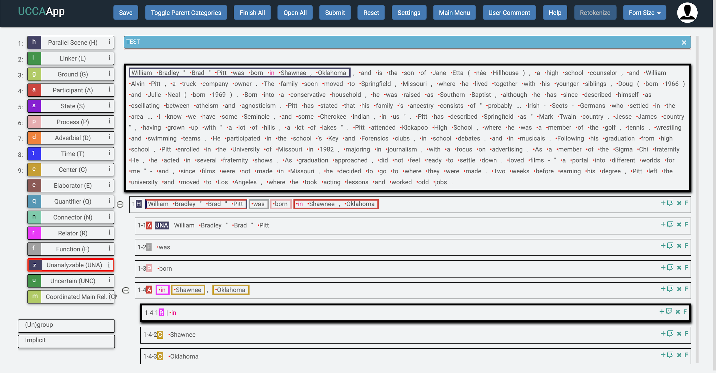
UCCA-App

Slide 7
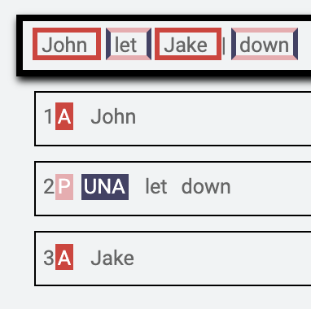
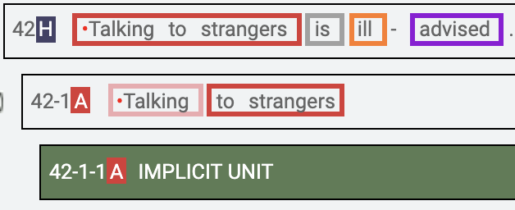
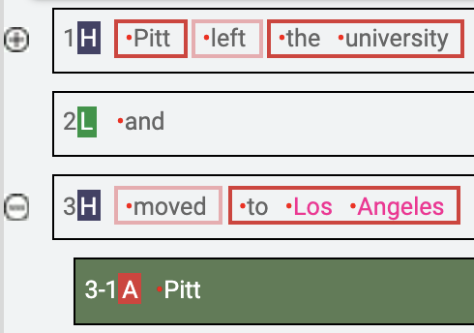
UCCA-App
Supports various properties such as:
Discontiguous phrases
Implicit sub-units (empty elements)
Remote sub-units (by allowing multiple parents)
Multi-layered architecture: extension and refinement layers (found useful)

